Slide 1

Course Title: ECO346 - Data Visualization Techniques for Economists
Assignment No: 01
Name: Umar Farooq
Registration No: FA24-BED-096
Variant: Punjab Rural (Variant 0)

Slide 2
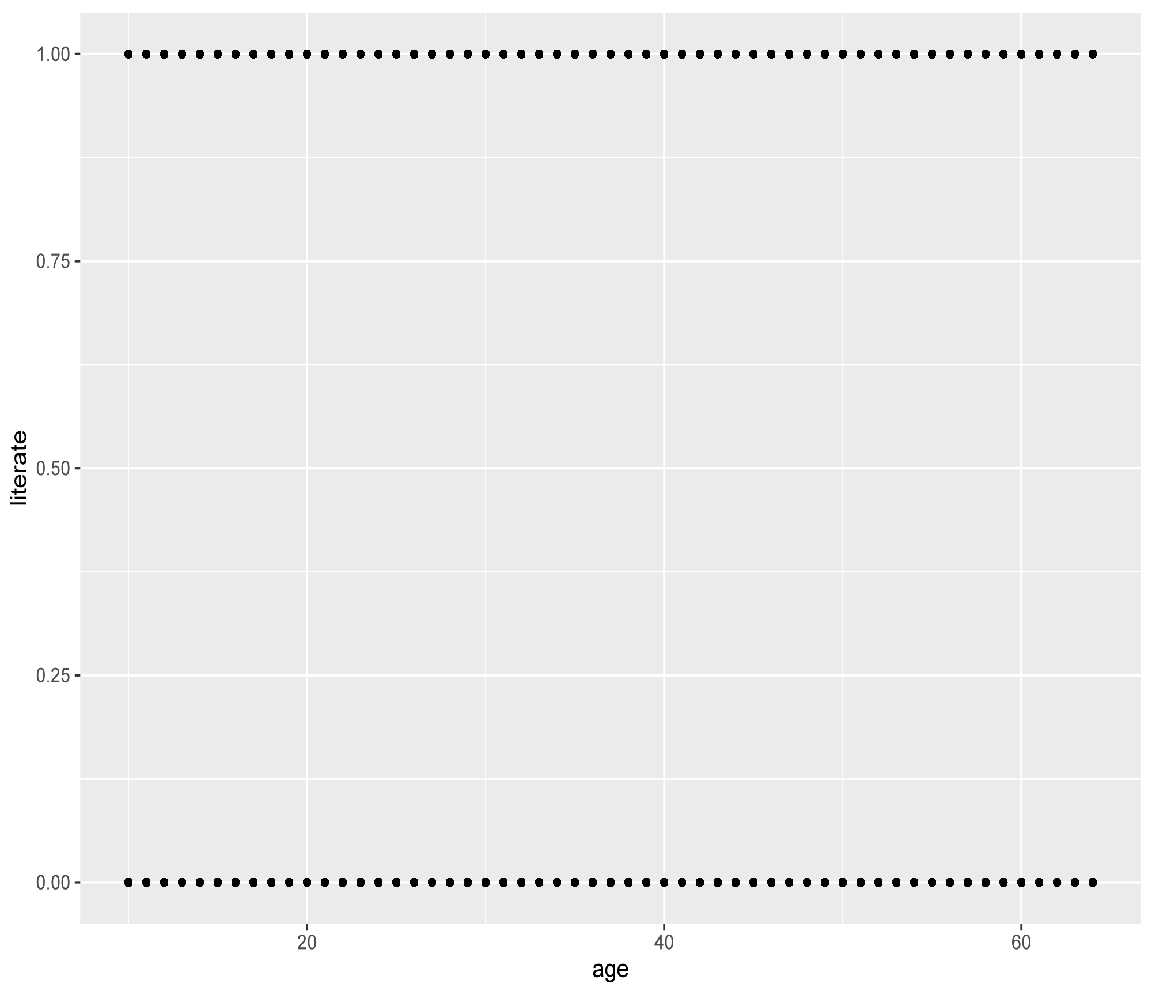
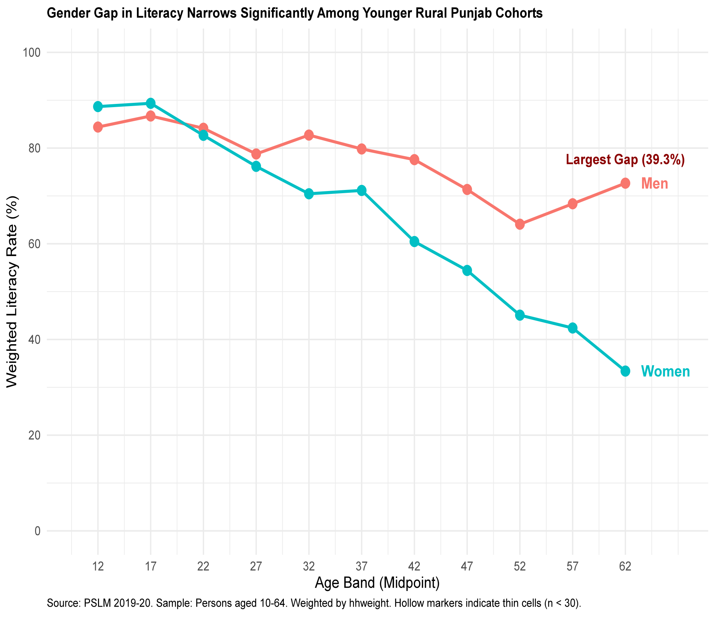
The Makeover: Default vs. Redesign
R Default Scatterplot (default.svg)
Raw ggplot2 default settings with unweighted observations.
Binary 0/1 points cause severe overplotting and obscure actual trends.
Refined Visualization (literacy.svg)
Aggregated by 5-year age bands with survey weights applied (hhweight).
Direct gender labeling, hollow markers for thin cells, and clear trendlines.

Slide 3
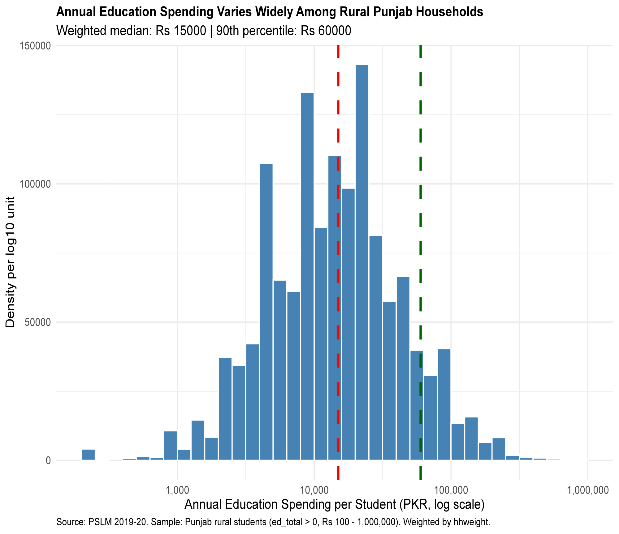
    Annual Education Spending Varies Widely Among Rural Punjab Households
Weighted median: Rs 15000 | 90th percentile: Rs 60000

Slide 4
Key Economic Findings & Observations
Gender Gap Trajectory:Older age cohorts (50+) show a massive literacy gap (39.3%), whereas younger rural Punjab cohorts (10–19) show significant gap narrowing.
Education Spending Skewness: Annual household education expenditure is heavily right-skewed; visualizing on a log scale reveals true spending dynamics across income groups.
Methodological Consistency:Both R and Python (reticulate) implementations produce identical weighted estimates and band tables for Question 5.

Slide 5
Summary & Analytical Limitations
Summary & Key Takeaways:
Applying survey weights (hhweight) is critical for population-representative insights; raw scatterplots misrepresent actual literacy trends.
Direct data labeling and high data-ink ratio significantly improve visual readability for policy decisions.
Data & Methodological Limitations:
Observational Cross-Section:PSLM 2019-20 data is cross-sectional, meaning we cannot directly infer individual-level literacy progression over time (cohort vs. aging effect).
Sample Size in Thin Cells:Small sample sizes (n < 30) in older age bands introduce potential noise, which is why hollow markers are used to flag low confidence estimates.

